Slide 1
BUSINESS PROPOSAL
“Location Analysis” for Super Market
Submitted by
NANDHINI DEVI M
REG NO: 36822009
MCA

Slide 2
Team Members :
Descriptive analysis - Ananya Manoj
Diagnostic analysis - Harini K
Predictive analysis - Praveen R
Prescriptive analysis - Maghalakshmi R
Location analysis - Nandhini devi M
Cost analysis - Nithiyasri S

Slide 3
Location Analysis :
Location analysis for a supermarket dataset involves examining where stores are located, understanding customer behavior in different areas, and using this information to make decisions like choosing new store locations, optimizing supply chains, and improving overall business efficiency based on geographic insights.

Slide 4
Why location analysis is important for supermarket ??
Location analysis is crucial for a supermarket dataset because it helps supermarkets make informed decisions about where to place their stores, understand customer behavior in different regions, and optimize operational processes.
By analyzing geographic data, supermarkets can identify profitable locations, tailor product offerings to local preferences, optimize supply chain logistics, and strategically expand into new markets, ultimately leading to increased efficiency, better customer satisfaction, and improved overall business performance.

Slide 5
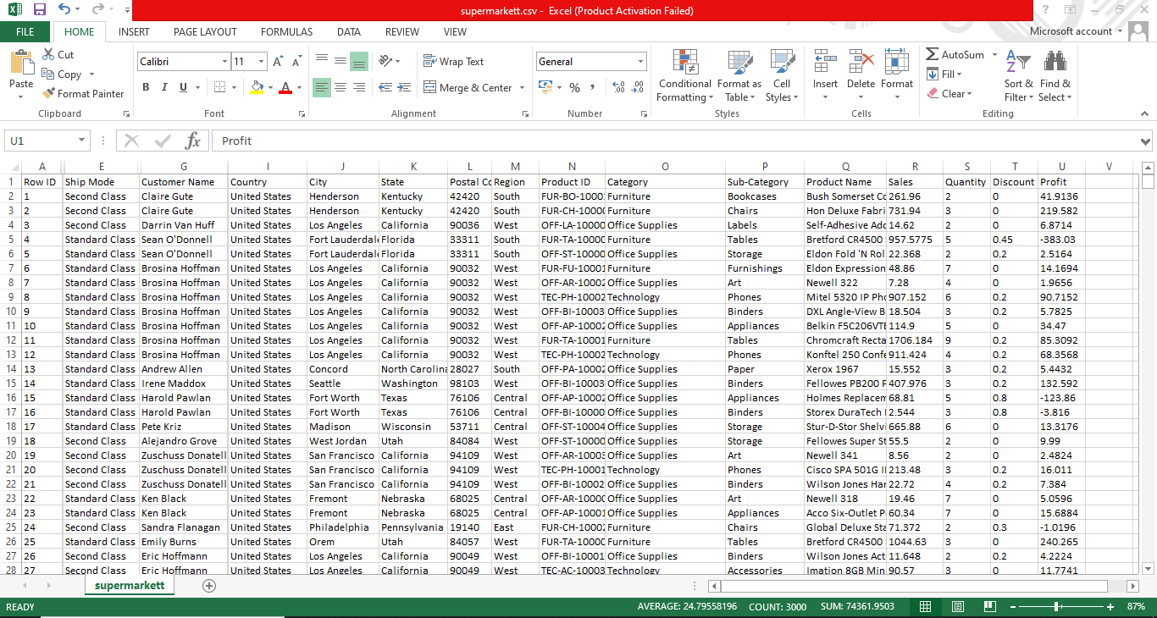
Dataset - supermarkett.csv
Double – click on that icon to access supermarket dataset (CSV File)

Slide 6
Attributes I had used for location analysis are:
Country
City
State
Region
Product
Sub-product
Profit
Sales
Discount

Slide 7
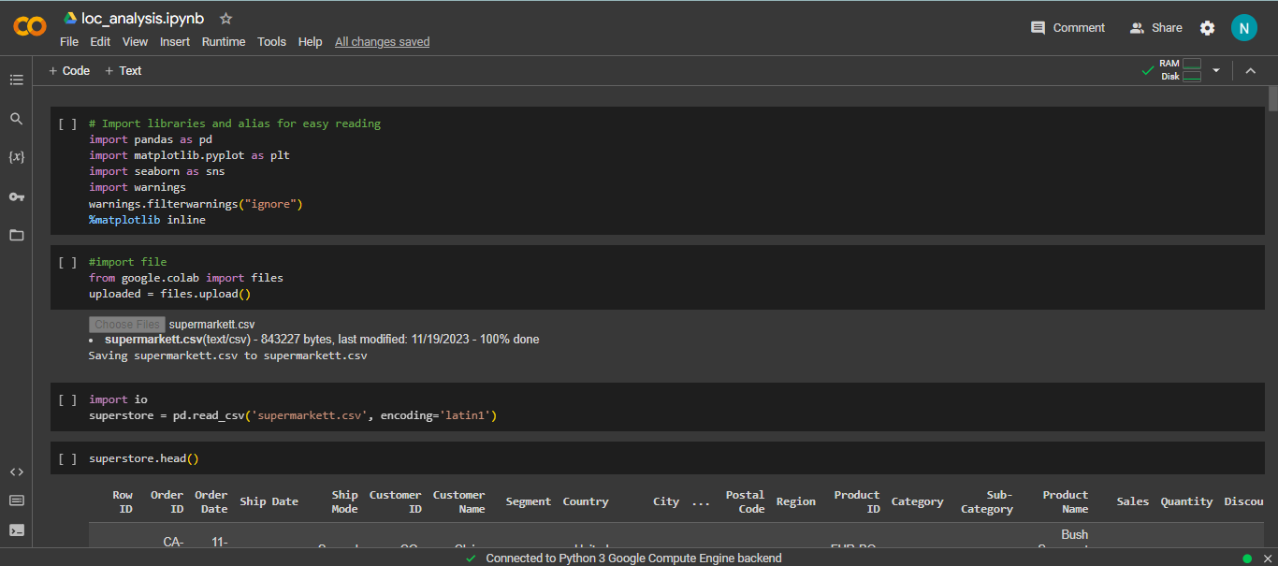
Implementation :
Step 1: Importing necessary libraries, upload dataset and reading csv file.

Slide 8
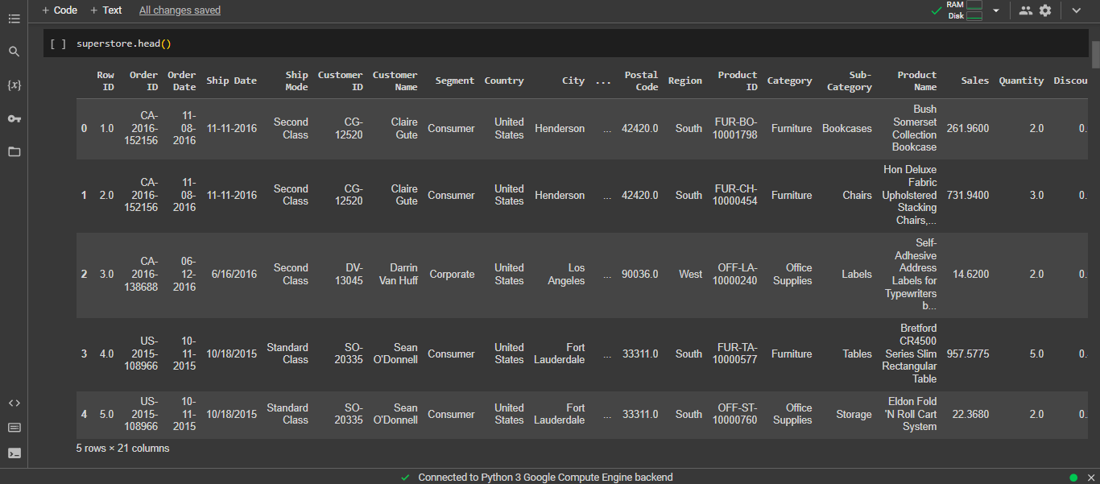
Step 2: Data Exploration

Slide 9
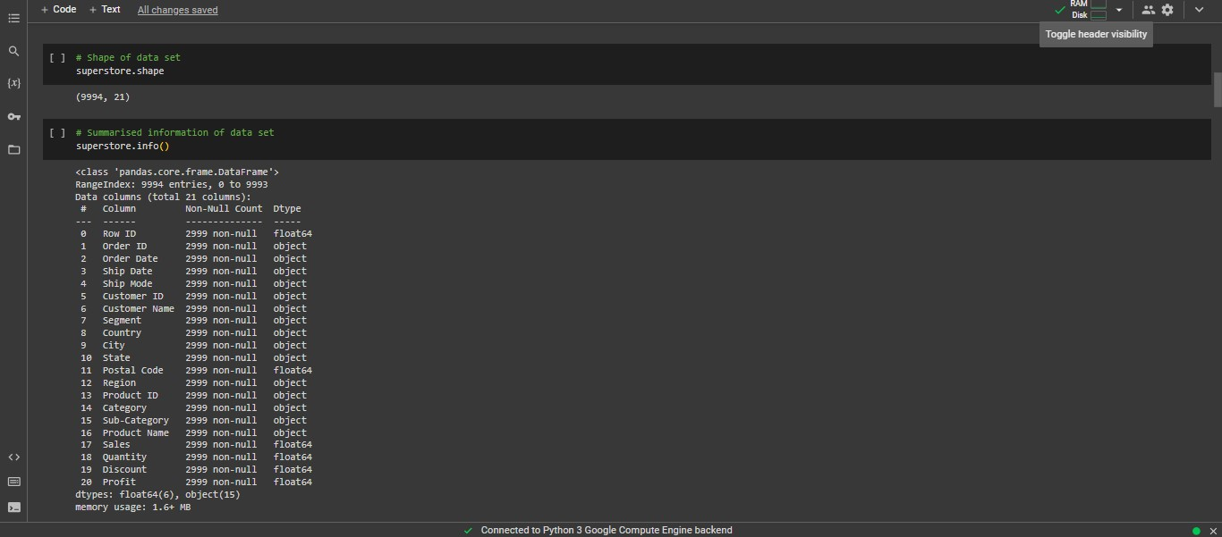
Step 2: (continue)

Slide 10
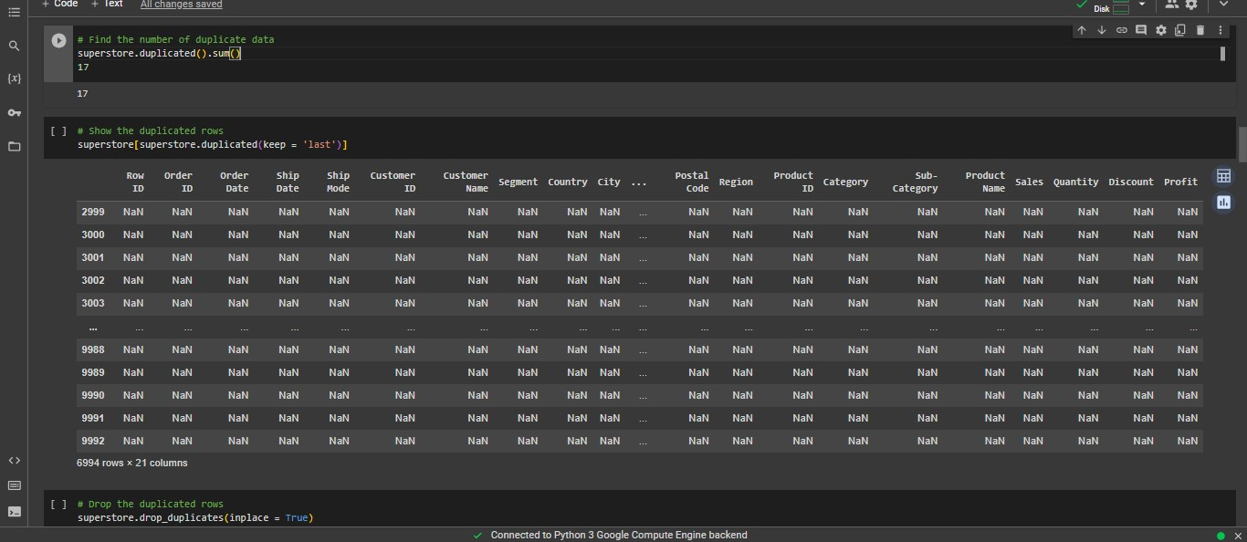
Step 3: Finding duplicate data

Slide 11
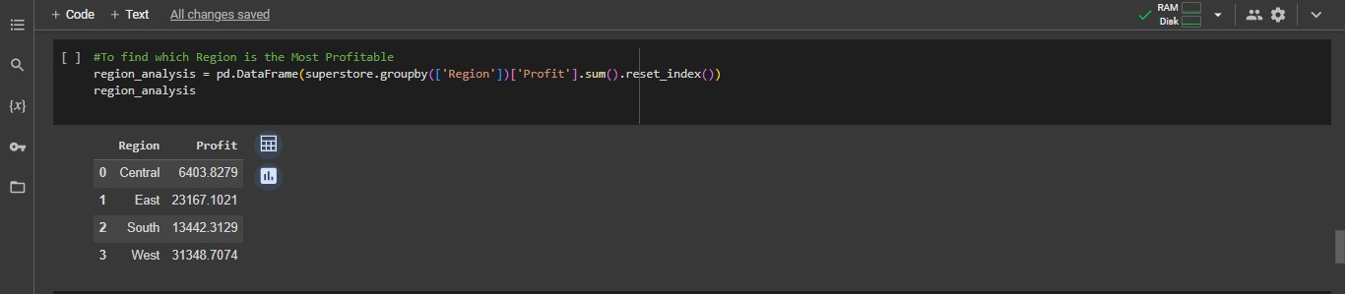
Analysis 1: Which Region is the Most Profitable ?

Slide 12
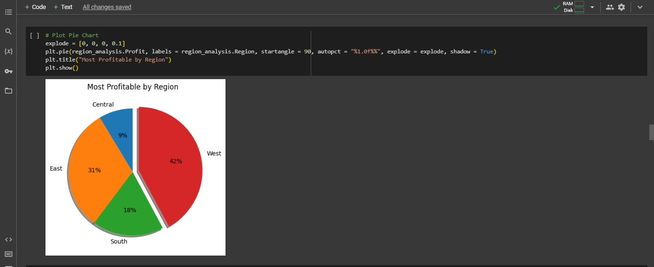
Output:
East and West region are most profitable.

Slide 13
Inference and interpretation:
Inference: The West region emerges as the most profitable, with a total profit of 108418.4489
Interpretation: The West region is a key driver of overall profitability for the superstore. Strategies that enhance performance in this region could significantly impact the company's bottom line.

Slide 14
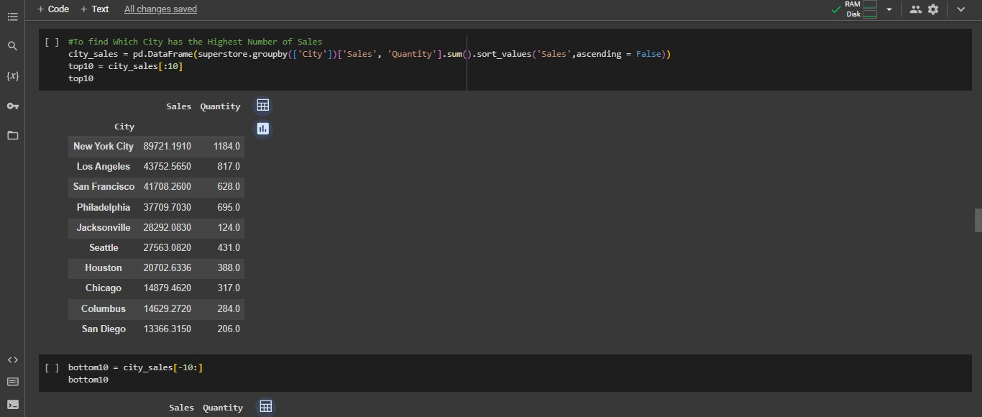
Analysis 2: Which City has the Highest Number of Sales?

Slide 15
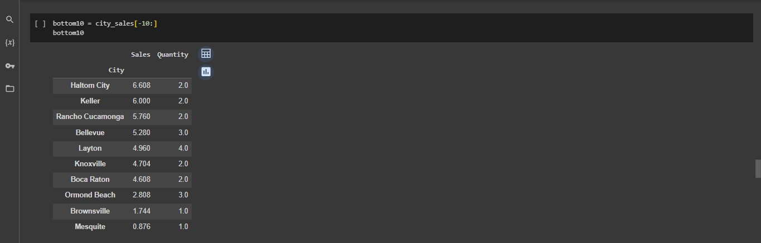
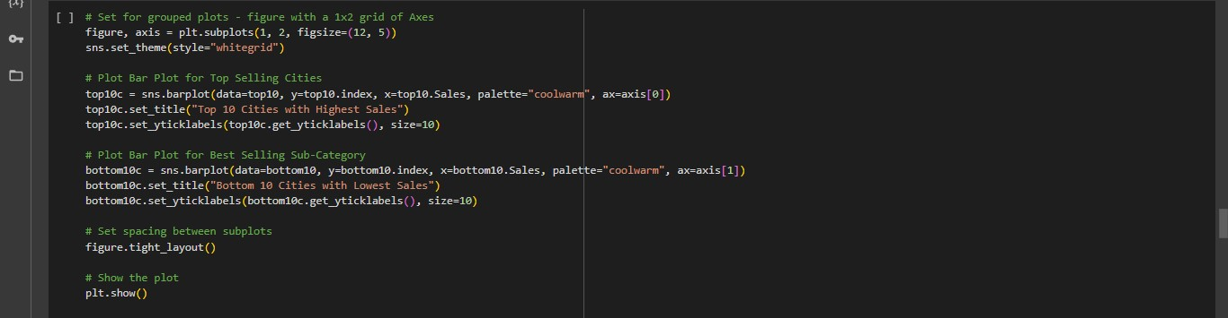

Slide 16
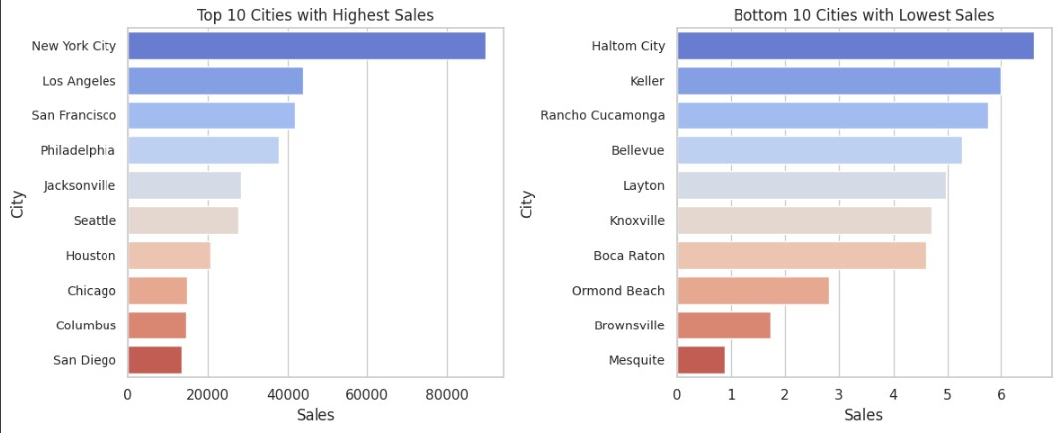
Output:
There is a huge disparity between the cities with highest sales and lowest sales. Marketing strategy has to target the top 10 cities.

Slide 17
Inference and interpretation:
Inference: Newyork city has first highest number of sales, totaling of units 80,000, Los angles city has second highest number of sales, totaling of units
40,000.
Interpretation: The quantity indicates that the Newyork city and Los angles city is the most successful in terms of sales volume.

Slide 18
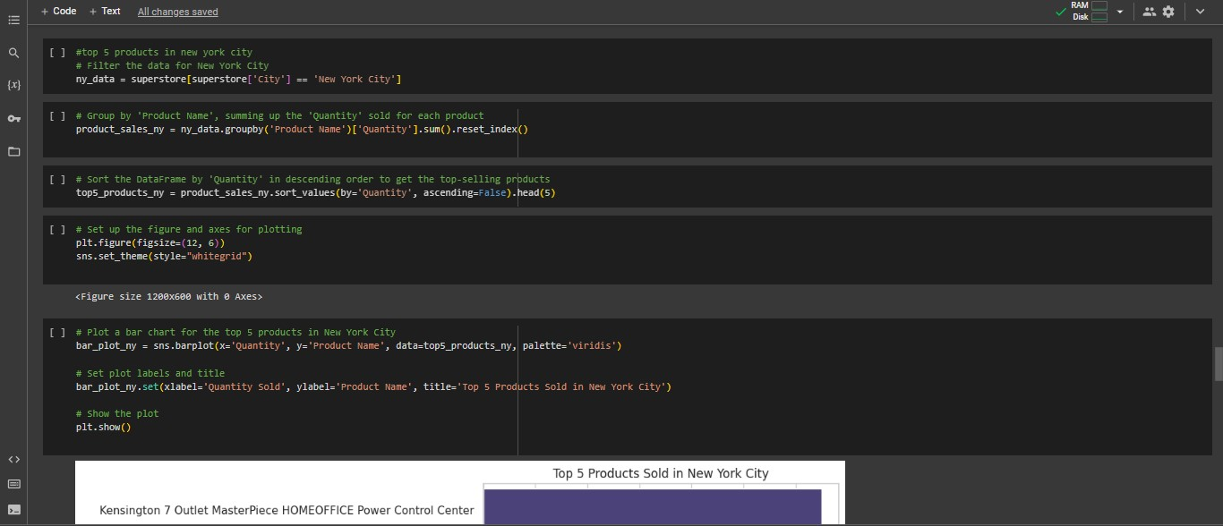
Analysis 3: Top 5 products in Newyork city.

Slide 19
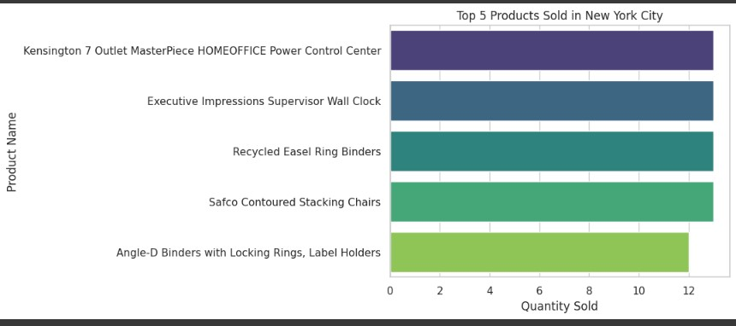
Output:

Slide 20
Inference and interpretation:
Inference: The top 5 products in New York City based on sales volume are:
wall clock, home office power control center, recycled esael ring binders, chairs, locking rings and label holders.
Interpretation: Products Wall clock, home office power control center, recycled esael ring binders, chairs, locking rings and label holders. are the most popular and successful in New York City in terms of sales.
Understanding the characteristics and demand for these products can guide inventory management and marketing strategies.

Slide 21
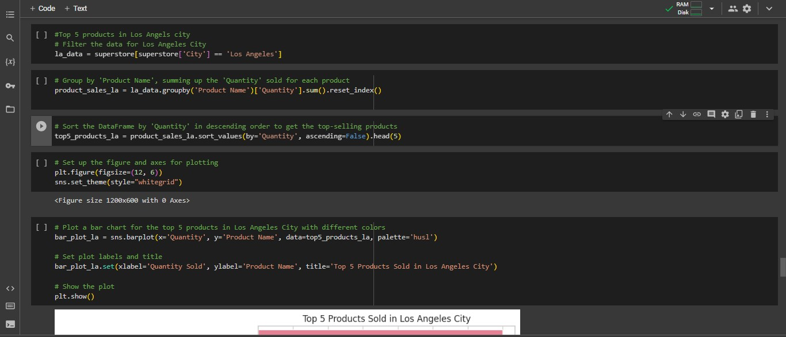
Analysis 4: Top 5 products in Los Angels city.

Slide 22
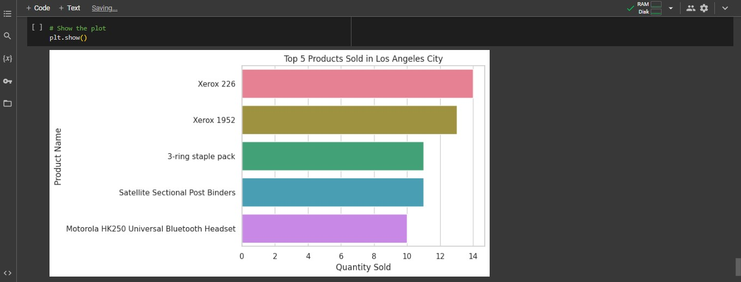
Output:

Slide 23
Inference and interpretation:
Inference: The top 5 products in Los angles City based on sales volume are:
Xerox 226, Xerox 1952, 3-ring staple pack, Satellite sectional post binders, Bluetooth headset.
Interpretation: Products Xerox 226, Xerox 1952, 3-ring staple pack, Satellite sectional post binders, Bluetooth headset. are the most popular and successful in Los angles City in terms of sales.
Understanding the characteristics and demand for these products can guide inventory management and marketing strategies.

Slide 24
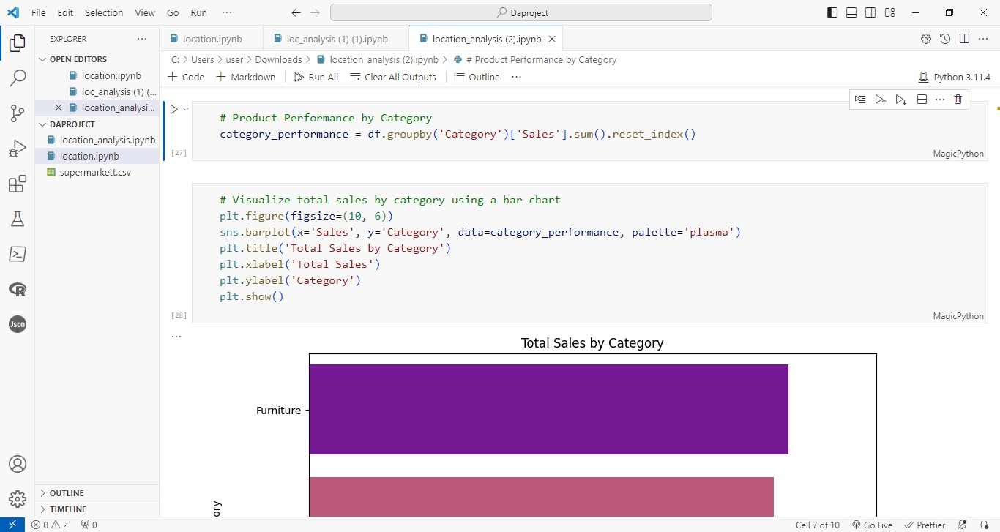
Analysis 5: Product performance by category.

Slide 25
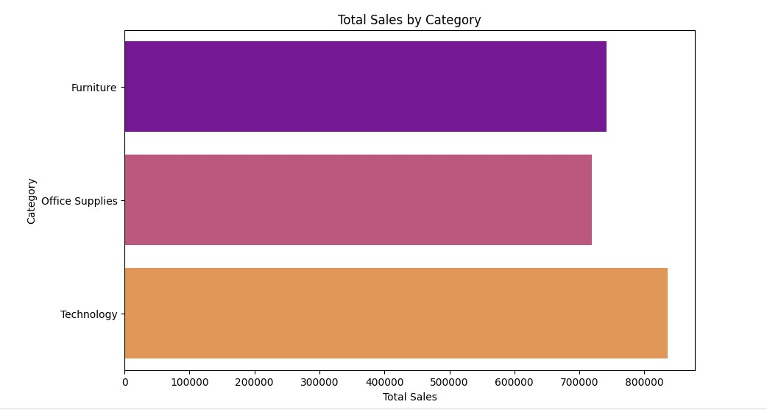
Output:

Slide 26
Inference and interpretation:
Inference: Products in the TECHNOLOGY category have the highest total sales and profit indicating strong performance in this category.
Interpretation: The 'Technology' category stands out as the top-performing category, driven by products such as office supplies and furniture. This suggests a high demand for technology compared to other categories.

Slide 27
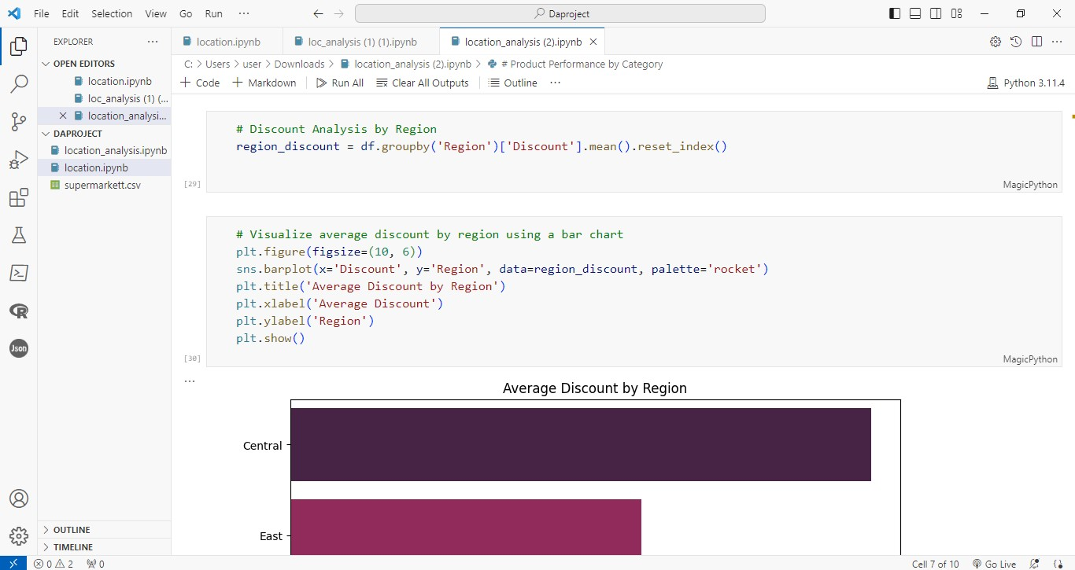
Analysis 6: Discount analysis by region.

Slide 28
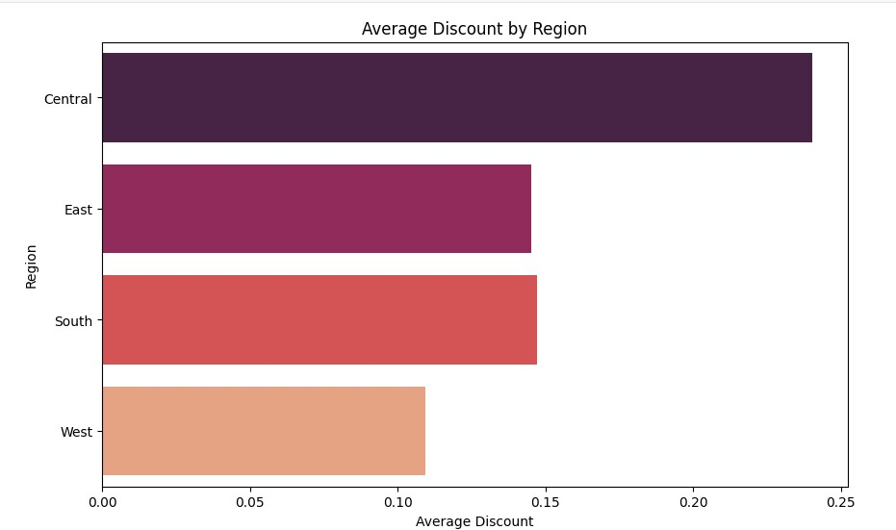
Output:

Slide 29
Inference and interpretation:
Inference: Discount in Central region have the highest discount and average discount by region indicating the strong discount analysis
Interpretation: The Central region reaches the highest discount than the east, south and west. This analysis performs a discount analysis by region

Slide 30
Thankyou

